Slide 1
Revelio: A Perception Effectiveness Assessment Approach for Graphical Patterns in Charts
Submission ID: 1415

Slide 2
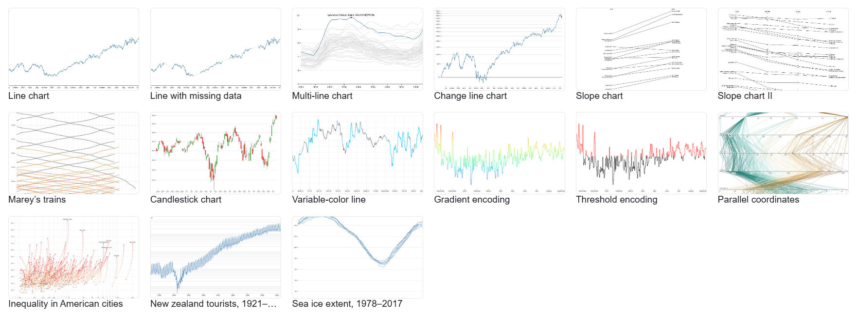
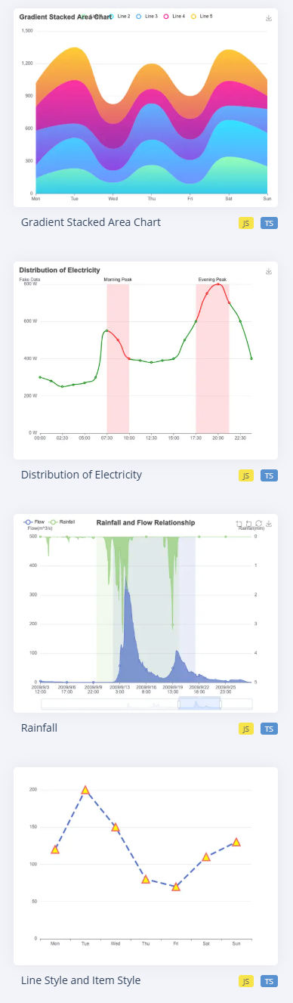
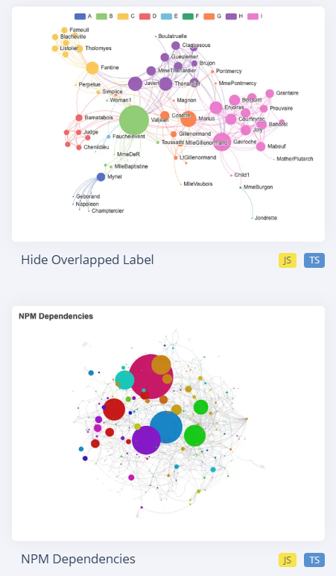


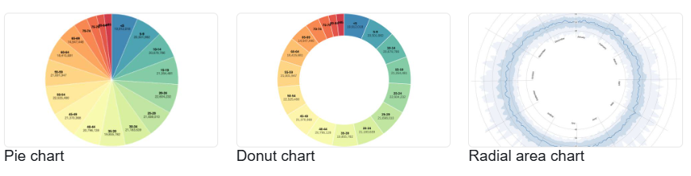
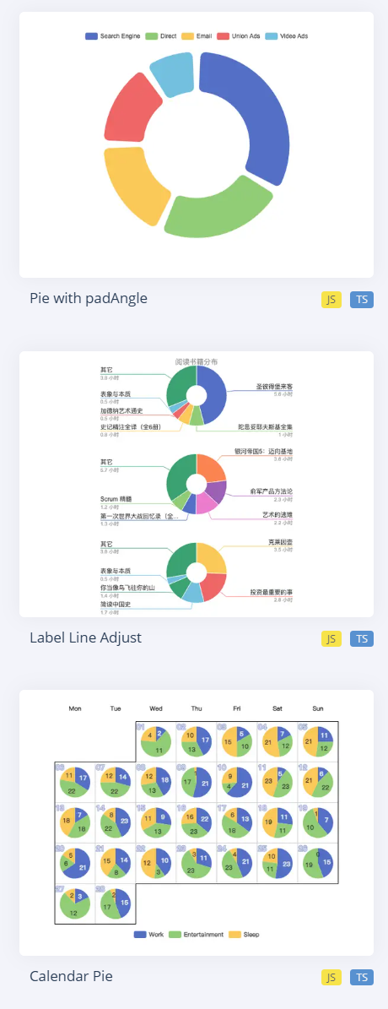
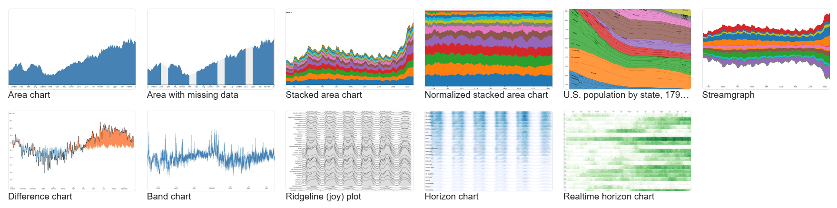

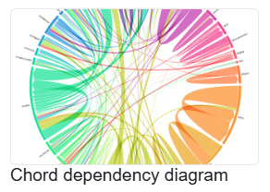
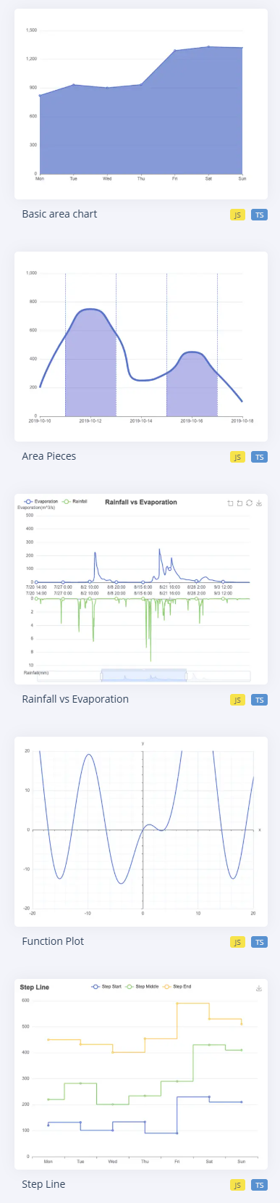

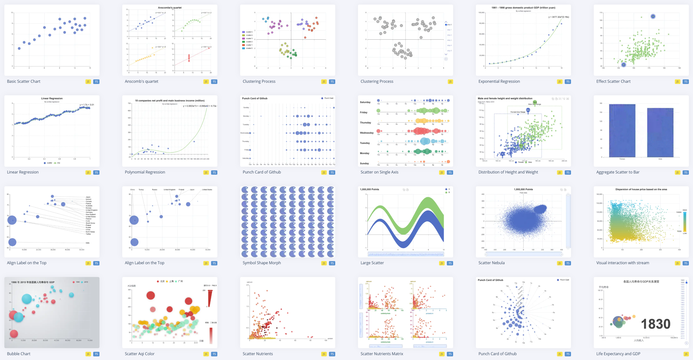
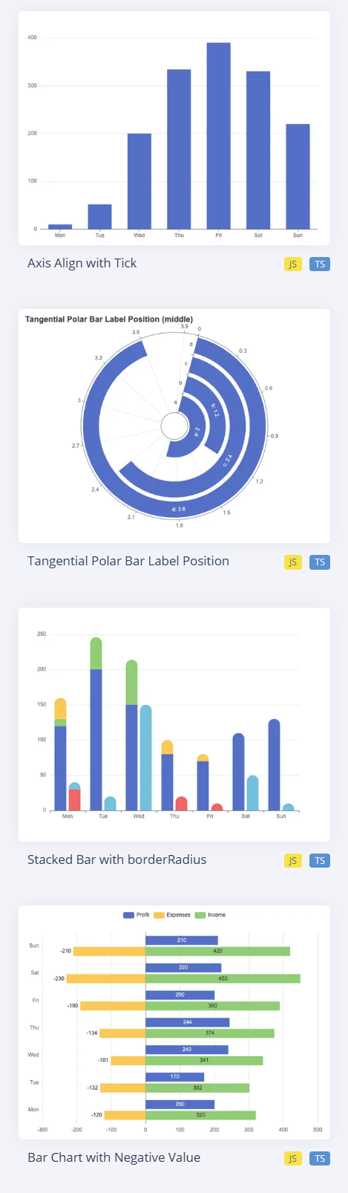
Creating charts is no longer difficult.
D3
ECharts
Highcharts
Chart.js
Chart authoring tools
Chart templates
Notes:
现在，创作可视化图表不再是一件难事。因为我们有很多便捷的图表创作工具，比如d3, Echarts，等等。同时，这些工具也提供了大量的图表模板供我们套用。即使没有系统地学过可视化设计，图表创作者也可以快速制作图表用于展示数据中的模式。

Slide 3
But how to make a choice?
D3
ECharts
Highcharts
Chart.js
Chart authoring tools
Chart templates
Notes:
但是，如何从大量可用模板中选择最能满足展示需求的图表设计依然是个问题。

Slide 4
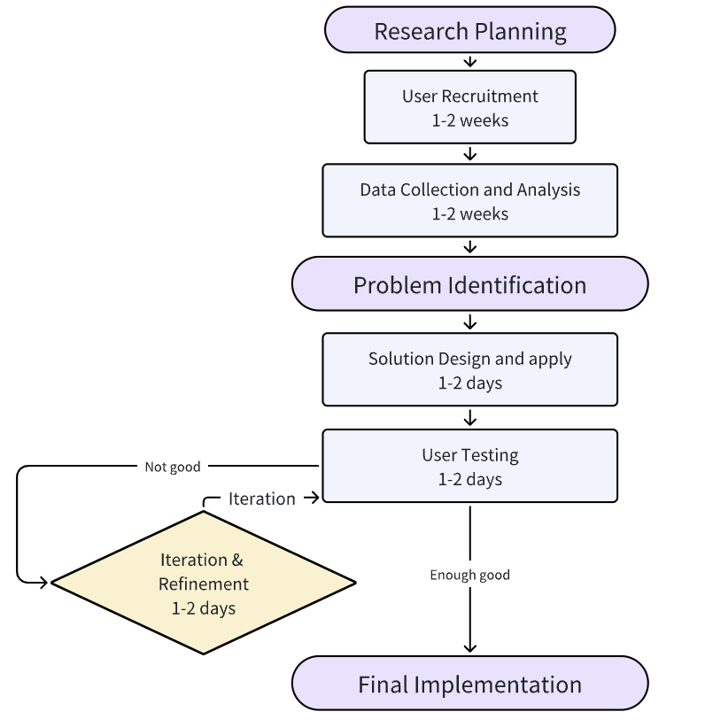
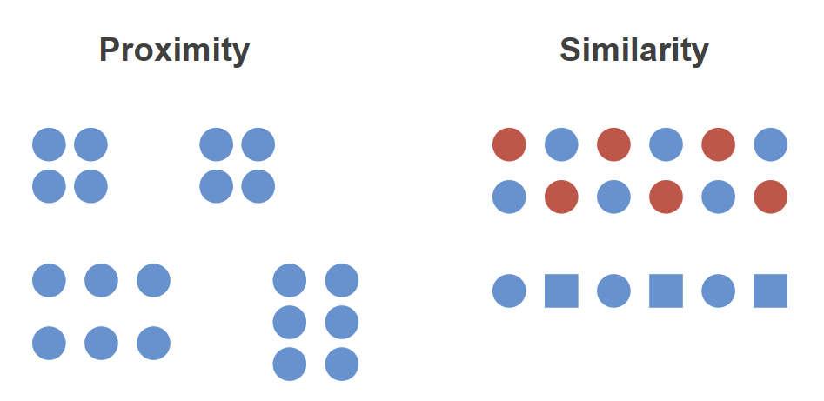
Assessing the representation effectiveness of charts is difficult.
Time-consuming
Confusing
User studies
Perception theories
Notes:
it is challenging to determine whether others can discern the message the author intends to convey through the chart.
评估图表的表达效果是一件很麻烦的事。标准流程是通过招募被试完成用户研究并根据结论进行判断。这是一个非常漫长的过程。有经验的图表设计师会运用感知理论对图表中的图形模式进行估计。但这个结果不一定准确，因为感知理论的协同作用机制很复杂，同时感知理论对没有经验的图表创作者而言也不容易应用。

Slide 5
Our Contributions
A graphical pattern identification approach for charts, which simulates human perception by integrating Gestalt Principles.
A prototype interface allows chart authors to assess their chart design and get suggestions.
Notes:
为了解决这个问题，我们提出了一个面向图表的图形模式识别方法，它通过整合格式塔原则实现了对人类视觉感知过程的模拟。同时，我们开发了一个原型系统，整合了这个方法来支持图表创作者评估他们的图表设计，并得到改进建议。

Slide 6
Design Goals
Identify graphical patterns based on visual perception of humans.
Simulate common perceptual behaviors.
Include diverse perceptual results.
Explain the perceptual mechanism.
Correlate visual effects with graphical patterns.
Compare visual effects of elements.
Suggest improvements for visual representation.
Analyze the current representation effects.
Recommend visual design for representing user-specified patterns.
Notes:
我们的方法设计遵循了3点目标：首先，在模拟人类感知时，需以大多数人的感知行为作为模拟对象，感知结果还需体现人类感知的多样性。第二，需要结合可视元素的视觉效果为感知机制提供解释。第三，需根据用户预期的模式展示效果评估图表并提供修改建议。

Slide 7
Introduction of Concepts
Concepts | Introduction
Visual encoding | Mapping data to visual effects (color for categories, bar height for values …)
Visual effect | Visual effects produced by the corresponding visual encoding. ( RGB(255, 0, 0) => Red )
Variance | Statistical measure of distribution in visual effects.
Perception scope | User specified element groups for perception simulation.
Graphical pattern | Elements formed automatically based on perception.
Elements group | Elements selected manually for testing while exploring.
Visual salience | How strongly a Graphical pattern or Elements group attracts people attention.
Bbox | Bounding box surrounding elements, used to evaluate positional importance.
HSL | Color model using Hue (color type), Saturation (intensity), and Lightness (brightness)
Notes:
在介绍我们的方法之前，需要先对一些将要出现的概念进行解释

Slide 8
Our Approach
Perception Simulation Formulation
Visual Effects Description
Chart Assessment
Graphical Patterns Identification
Perception Simulation Formulation
Visual Effects Description
Chart Assessment
Graphical Patterns Identification
Notes:
为了实现前面所说的3点目标，我们设计了一个图像模式识别方法，来支持图表评估和考虑模式表达效果的图表设计优化。我们的方法由4个模块组成。

Slide 9
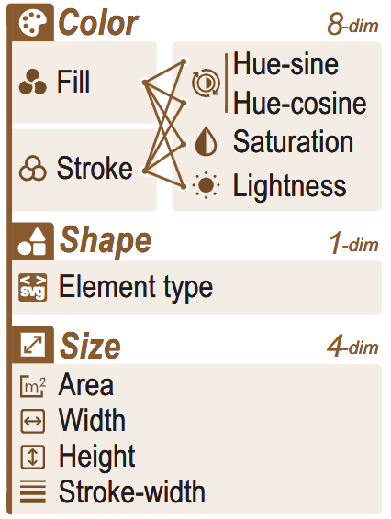
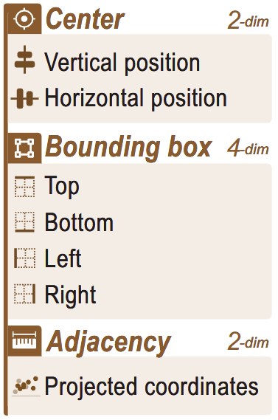





Our Approach
SVG code
<rect>
<circle>
<path>
Dissemble visual elements
Characterize visual effects
Perception Simulation Formulation
Visual Effects Description
Chart Assessment
Graphical Patterns Identification
Notes:
第一个模块从svg代码中解析可视元素，并生成对元素视觉效果的结构化描述。

Slide 10

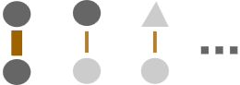


Our Approach
Contrastive
learning model
Perceptual
features
Positive
pairs
Group
annotation
Negative
pairs
{F1，F2，…}
Inject perception patterns
Extract perceptual features
Perception Simulation Formulation
Visual Effects Description
Chart Assessment
Graphical Patterns Identification
Notes:
接下来，我们通过用户实验收集了人类对图表中图形模式的感知结果，用于训练对比学习模型，得到了能够解释视觉效果协同作用于感知结果的感知特征。

Slide 11
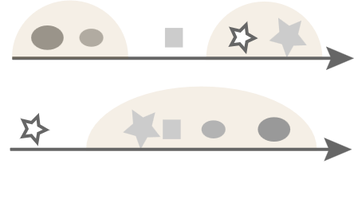
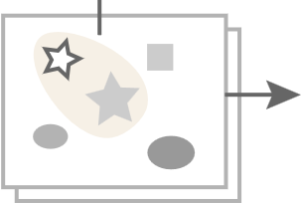
Our Approach
Graphical pattern
Similarity
Fi
High
Within
Chart
{Fi，Fj}
In/out
Low
Group visual elements
Measure pattern salience
Perception Simulation Formulation
Visual Effects Description
Chart Assessment
Graphical Patterns Identification
Notes:
基于感知特征，我们可以从图表中识别可视元素的分组。同时，我们还为这些元素组计算了显眼程度。

Slide 12
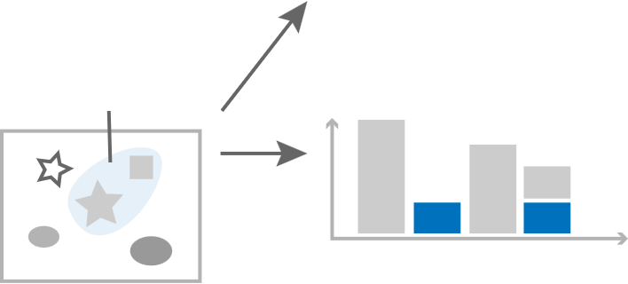
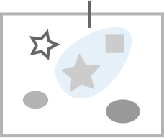

Our Approach
Selected
element
group
Salience score
Expected
pattern
#Elements
Add a new
channel
(e.g., hue)
Suggestion:
Visual effect
Support pattern exploration
Suggest design improvement
Perception Simulation Formulation
Visual Effects Description
Chart Assessment
Graphical Patterns Identification
Notes:
最后，我们支持用户通过探索元素组合理解感知效果。并为元素组合提出如何加强感知效果的图表设计修改建议。

Slide 13
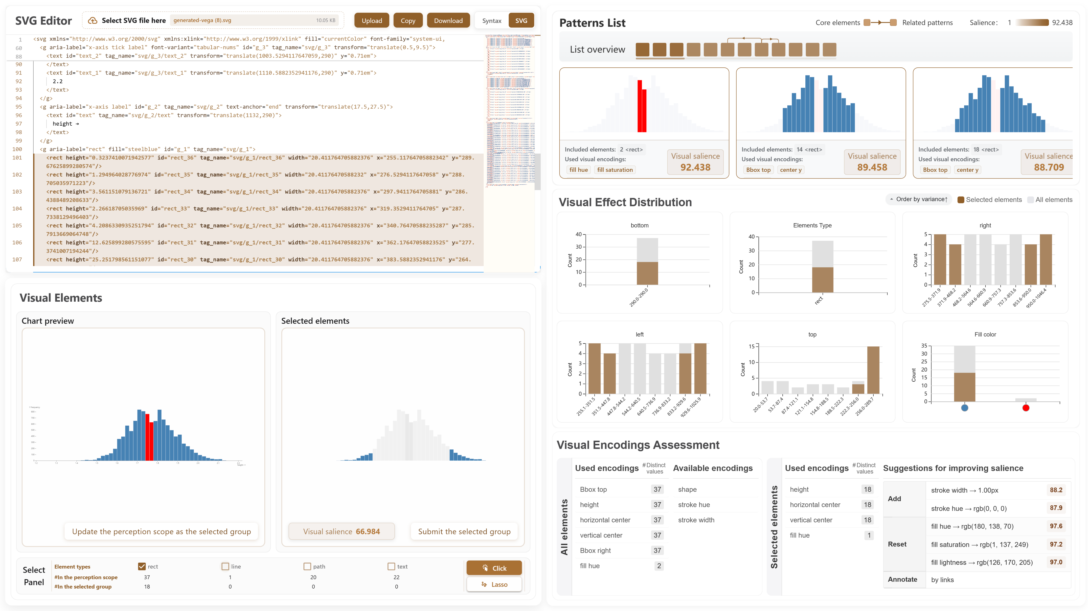
Interface

Slide 14
Interface

Slide 15
Interface

Slide 16
Interface

Slide 17
Interface

